Slide 1
Getting Started with Python 3 and Anaconda
PHYS3112 – Tutorial 1

Slide 2
Welcome, Housekeeping and General Tutorial Format
The purpose of these tutorials is to
Expose you to different types of numerical methods and their uses
Provide you with experience in implementing the above
Provide a format for you to get help with python!
General Tutorial Format:
15 Minute Presentation on Topic
JuPyTer notebook with worked examples and homework
Assistance with general Python / computing problems
Need Help? Contact me at matthew.gerges@unsw.edu.au , or through moodle questions

Slide 3
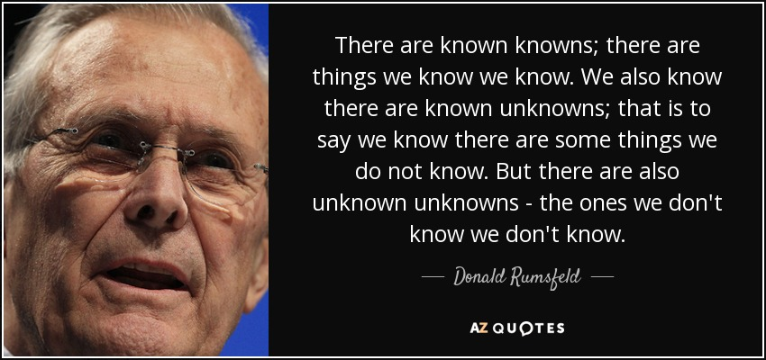
Notes:
Can’t teach everything
Just move things from unknown unknown to known unknown
Then you find them and become known known

Slide 4
Onboarding! – Downloading and installing Python
Install Anaconda (which has EVERYTHING in it)
Learn how to ‘use’ Anaconda/Python
Learn how to install packages in Python

Slide 5
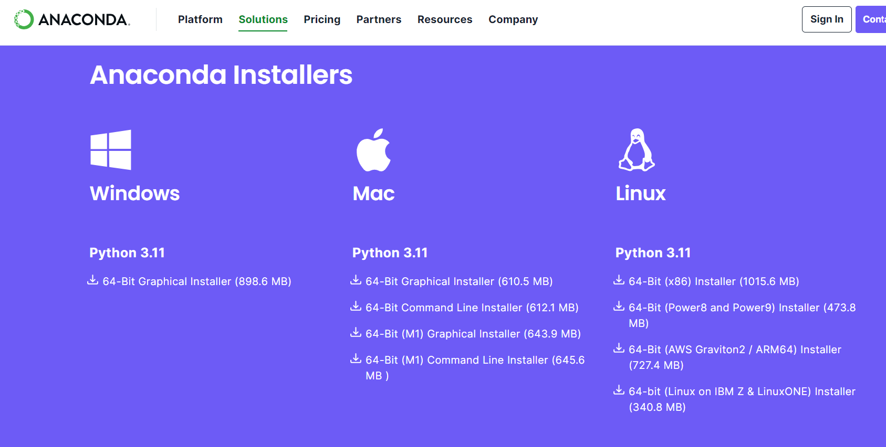
Anaconda – A Scientific Python Package
Go to https://www.anaconda.com/download and grab the Python 3.11 Version
(Python 3 and Python 2 are mildly different versions of Python – we will focus on ‘3’ but you will see some things written for 2 in the wild!)
Once it’s downloaded, open ‘Anaconda Navigator’ – this is going to be your main hub page for Anaconda!

Slide 6
“Using” Python
Two steps to using Python (and code in general);
Write your instructions (Write)
Send the instructions to the Python ‘executable’ (Run / Execute)
Conventionally, this is done using two separate programs; a text editor to write, and a command line / other interface to run the program.
An Integrated Development Environment (or IDE) allows you to both Write and Run code in the same program.
Anaconda comes bundled with two IDEs that we will examine:
Spyder
Jupyter Notebook

Slide 7
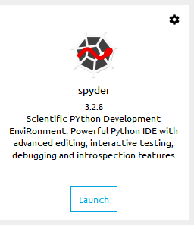
Spyder
An IDE that looks a lot like matlab’s IDE
Useful for debugging – variable viewing is pretty easy!

Slide 8
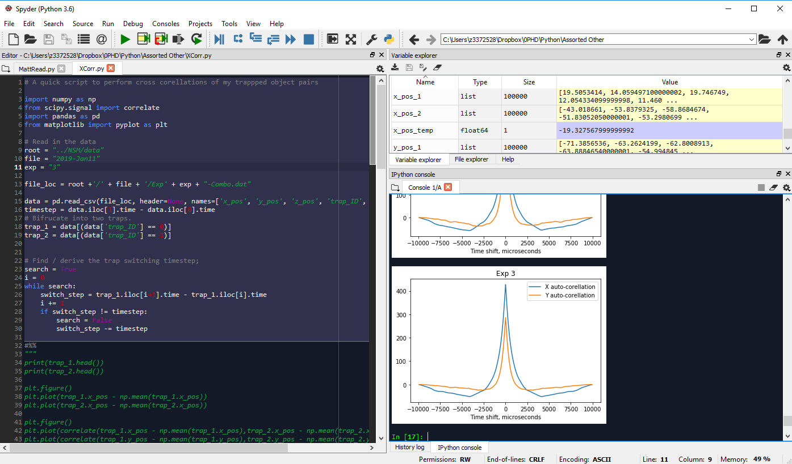
Run Code (or segments)
Look at Variables
Write code here (it is saved to a FILE)
Output appears here.
You can also use this console to write code that is immediately run.
#%% is the ‘New Segment’ indicator

Slide 9
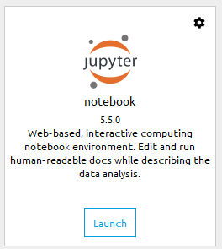
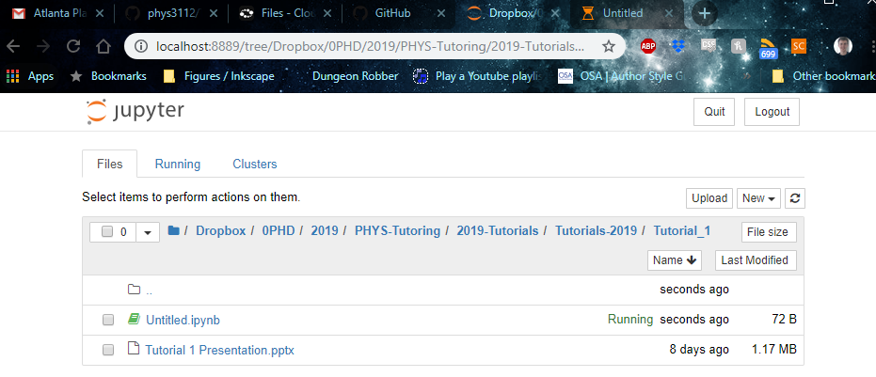
Jupyter Notebook
Notebook that lets you write documentation and code side by side
In-browser, but it’s accessing your LOCAL files!

Slide 10
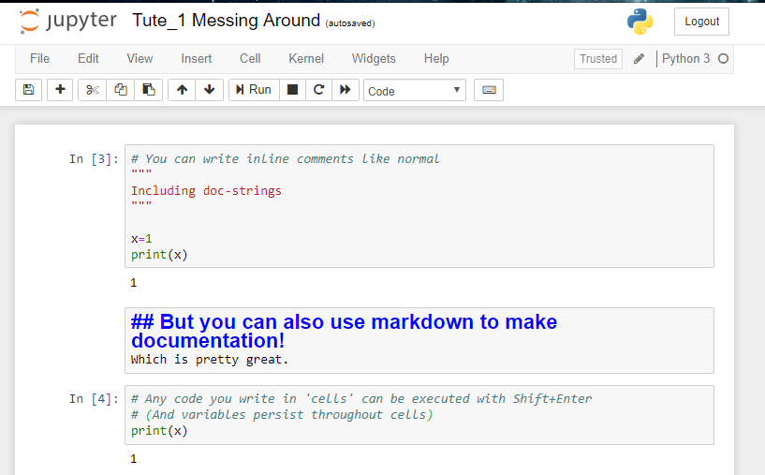
Change From Code
To Markdown

Slide 11
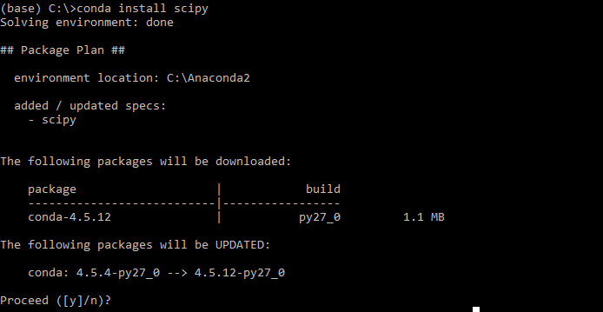
Installing Packages
Open ‘Anaconda Prompt’ and type: conda install <package_name>
Eg conda install scipy -> this will install the scipy package
Notes:
Try not to use pip if conda is available

Slide 12
Learning Python
The purpose of this course is to teach you techniques, not syntax.
That said, you should learn the following;
Mathematical operations (+, -, *, etc)
Data storage and types (integer, string, NumPy array) and how to ‘get at them’.
For loops, While loops, If statements
Writing and Calling functions
You can always contact me for help if you get stuck.
Good website to learn; https://automatetheboringstuff.com/

Slide 13
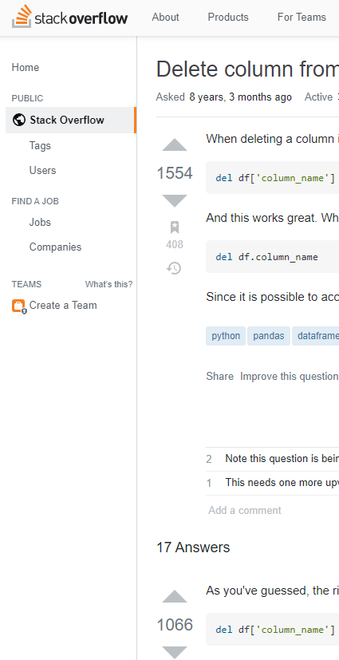
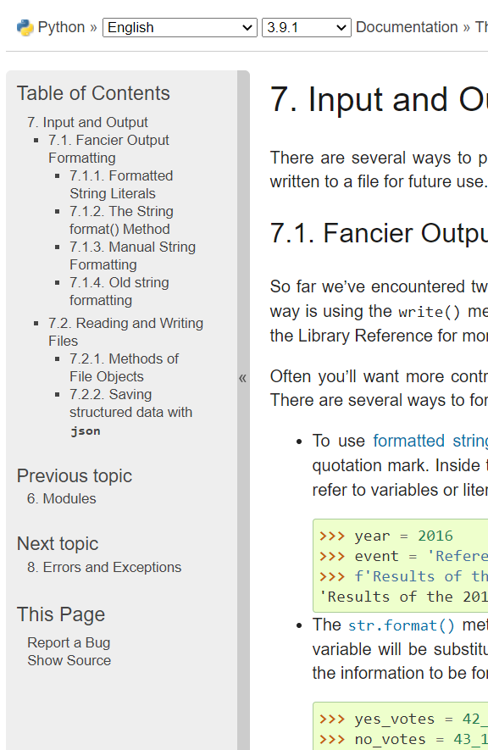
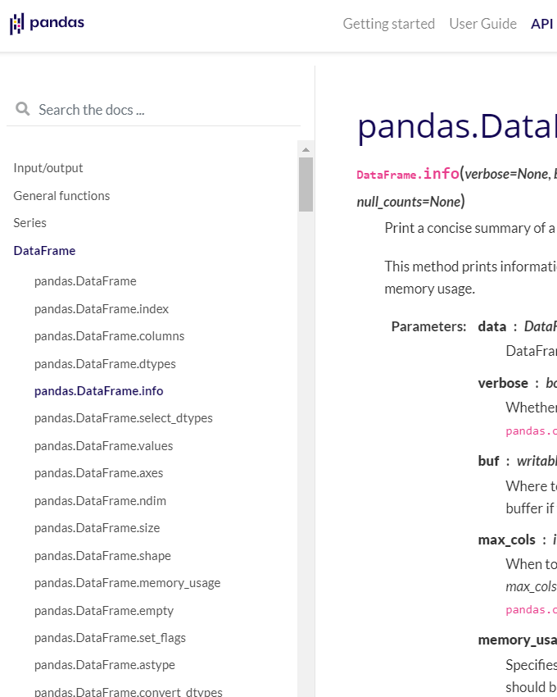
Notes:
End up on one of these while learning
Stack overflow for general questions
Python documentation for built in things
Specific packages documentation eg Pandas

Slide 14


A word on AI
Notes:
Chatgpt vs gemini
Make you a bad programmer

Slide 15
GitHub
All tutorial slides and notebooks are uploaded to GitHub:
https://github.com/phys3112/Tutorials-with-Matt
Michael Ashley also has a GitHub repository with some useful notes, for example the intro notebook is a good place to start for beginners.
https://github.com/phys3112/intro

Slide 16
End of Tutorial!
Please don’t go until you have gotten access to github and installed anaconda.
Next week, we will already be learning some python (and not basic stuff either!).

